Slide 1
Academic Writing in English
Lecture 1
Introduction to the Course

Slide 2
Course Description
Part I

Slide 3
Course Description
Aims
This course aims to introduce to the students English academic writing, in particular, the strategies for writing an academic paper.
The students are expected to understand the process and grasp the basic techniques of writing academic papers.

Slide 4
Course Description
2. Objectives
Improve academic writing knowledge and skills to a level appropriate to university (graduate) level work.
Be able to produce well-organized and written academic essays with appropriate citation and referencing.
Develop vocabulary and grammatical accuracy.
Take greater responsibility for the improvement of English language skills both in and beyond the classroom.

Slide 5
Course Plan
Part II

Slide 6
Course Plan
Week 1：
Introduction to The Course
aims and objectives;
course plan;
…
Format Requirements
Assessment: Classroom Practices, Essays and Quiz
Common Errors ( optional )

Slide 7
Course Plan
Week 2：
Lecture Content:
Topics, Thesis and Topics Sentences
Classroom Practice:
Writing a Thesis / Topic Sentences
Optional Introduction:
Writing a Definition

Slide 8
Course Plan
Week 3:
Lecture Contents:
Features of Academic Writing (1)
Introduction and Conclusion Paragraphs Writing
Classroom Practice:
Writing an Introduction and a Conclusion for a research paper

Slide 9
Course Plan
Week 4
Lecture Content:
Features of Academic Writing (2)
Abstract Writing Skills
Classroom Practice:
Writing an Abstract for a research paper

Slide 10
Course Plan
Week 5
Lecture Content:
Text Organization of an Academic Essay
Outline Writing Skills
Classroom Practice:
Writing an Outline
Academic vocabulary (Optional)

Slide 11
Course Plan
Week 6
Lecture Contents:
Paragraph Organization
Types of Paragraphs
Comparison and Contrast — from paragraph to essay
Classroom Practice:
Paragraph Writing

Slide 12
Course Plan
Week 7
Lecture Content:
Cause and Effect — from paragraph to essay
Classroom Practice:
Paragraph Writing
Parallelism (optional)

Slide 13
Course Plan
Week 8
Lecture Content:
Problem and Solution — from paragraph to essay
Classroom Practice:
Paragraph Writing
Discussion Essay Writing (optional)

Slide 14
Course Plan
Week 9
Lecture Content:
Argumentation and refutation — from paragraph to essay
Classroom Practice:
Paragraph Writing

Slide 15
Course Plan
Week 10
Lecture Contents:
Transitions
Paraphrasing Skills
Course Review
Classroom Practice:
Paraphrasing Practice

Slide 16
Course Plan
Week 11
Quiz for this Course

Slide 17
Course Procedure
Part III

Slide 18
Lecture Procedure
Comment on last classroom practice
First section
Second section
Classroom Practice ( always one paragraph writing, about 120 words )

Slide 19
Referenced textbooks and Websites
Part IV

Slide 20

Recommended Textbook
Academic Writing – A Handbook for International Students by Stephen Bailey
Academic Writing—from paragraph to passage
by Dorothy E Zemach & Lisa A Rumisek
Essays for studies

Slide 21
Recommended Websites
https://owl.english.purdue.edu/owl/section/1/2/
http://www.uefap.com/writing/feature/featfram.htm
https://www.esc.edu/online-writing-center/resources/academic-writing/
http://www.monash.edu.au/lls/llonline/writing/general/academic/index.xml

Slide 22
Types of academic writings
Part V

Slide 23
Types of Academic Writing
1. Research Paper
A research paper is a piece of writing
--- to summarize or synthesize information and ideas gathered from research
--- to explain, compare and contrast, evaluate, or analyze concepts, events, and phenomenon
--- to argue for or against a position in an ongoing debate

Slide 24
Types of Academic Writing
Academic papers are often required in college courses, particularly in the U.S. and U.K.
Writing Academic papers is very crucial for graduate studies.
The ability to write good Academic papers is often highly valuable for one’s future career.
Sample Research Paper

Slide 25
Sections of Research Paper
Experimental process | Section of Paper
What did I do in a nutshell? | Abstract
What is the problem? | Introduction
How did I solve the problem? | Materials and Methods
What did I find out? | Results
What does it mean? | Discussion
Who helped me out? | Acknowledgments (optional)
Whose work did I refer to? | Literature Cited
Extra Information | Appendices (optional)

Slide 26
Types of Academic Writing
2. Academic Essay
An essay is a piece of writing that usually has five or more paragraphs.
An essay is written about one topic that has several main points. The main points are introduced in an introductory paragraph and supported in body paragraphs. The conclusion is the last paragraph.
Sample Five Paragraph Essay

Slide 27
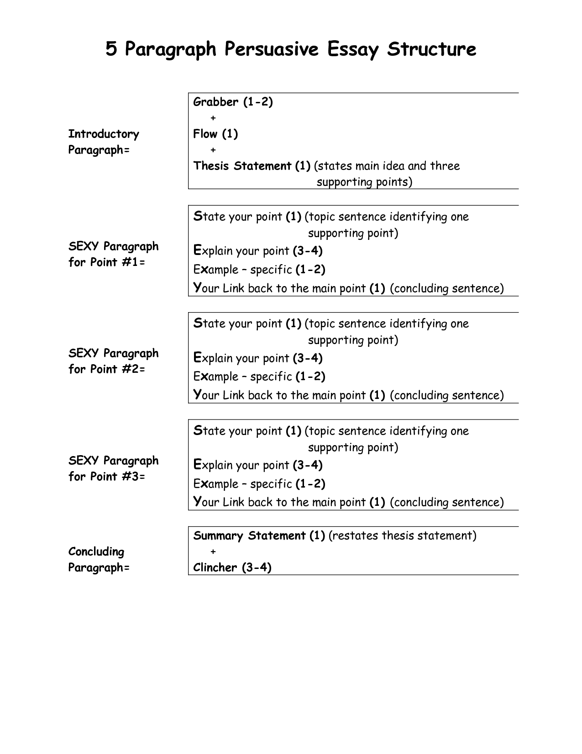

Slide 28
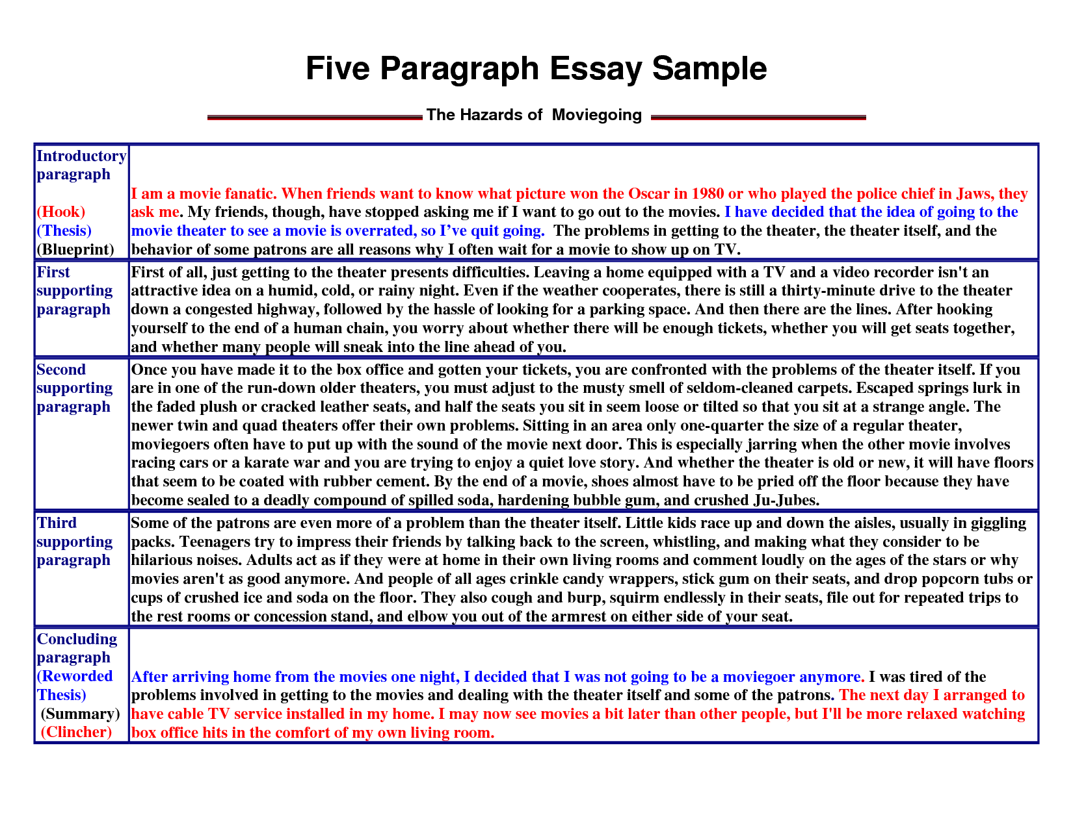

Slide 29
Types of Academic Writing
3. Others:
formal letters;
CVs;
Surveys;
…

Slide 30
Academic Writing for This Course
Five-paragraph essay writing
Focuses:
Format;
Text Organization;
Paragraph Development

Slide 31
Assessment
Part VI

Slide 32
Assessment
1. Attendance and Performance: 20%；
2. Classroom Practice: 30%；
3. Online Assignments: 30%；
4. Quiz Essay: 20%。

Slide 33
Assessment
1. Physical Attendance:
more than 7 times’ attendance or zero grade
2. Classroom Practice:
more than 7 times’ classroom writing practice hand in on time or zero grade
Online Assignments:
All 3 essay writings
4. Quiz Essay:
no excuse for absence

Slide 34
Assessment
About Online Assignments:
Website for writing assignments http://www.pigai.org/
http://www.pigai.org/yj2016
Register with your:
Real name
Real student ID
Class name

Slide 35

Format Requirements
Format Requirements

Slide 36
Format Requirements
Classroom Practice: (1 paragraph writing)
Self-statement
or:
Reasons for Me to Choose This Course (Passage writing)

